Slide 1
Pulmonary Rehabilitation
Student’s Name
Course
Professor

Slide 2
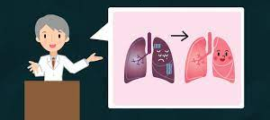
WHAT IS PR?
A Multidisciplinary programme of care for patients with chronic respiratory impairment that is individually tailored and designed to optimise physical and social performance and autonomy.
BTS statement 2001

Slide 3
Pulmonary Rehabilitation
Pulmonary rehabilitation is the use of exercise, education, and behavioural intervention to improve how people with chronic lung disease function in daily life with a view of enhancing their quality of life.
Levine & Stankiewicz (2020)

Slide 4
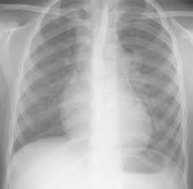
Who Needs PR?
People with a lung condition whose ability to be active is affected by breathing difficulties need PR.
It can benefit people with long-term lung conditions, such as:
Bronchiectasis
Pulmonary Fibrosis
Asthma
Chronic Obstructive Pulmonary Disease (COPD).
PR is further recommended to people leaving hospital after a COPD flare-up. Levine & Stankiewicz (2020)

Slide 5
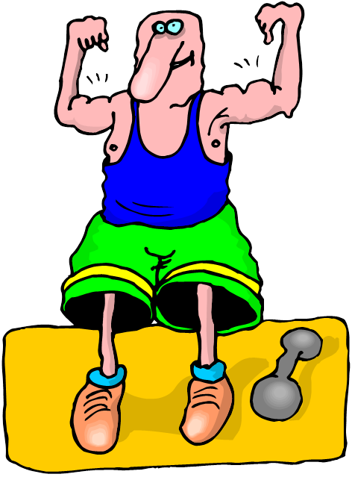
Benefits of PR
PR can:
improve muscle strength to use the oxygen,
Help breathe more efficiently, and become less breathless
help cope better with feeling out of breath
improve fitness and be confident to do daily tasks
help feel better mentally
help understand and manage the condition better.
(British Lung Foundation, 2020).

Slide 6
Components of Pulmonary Rehabilitation
A pulmonary rehabilitation program has several components, including
Exercise training
Inspiratory muscle training
Psychosocial counselling
Nutritional evaluation and counselling
Neuromuscular electrical stimulation
Education, including on proper use of prescribed drugs

Slide 7
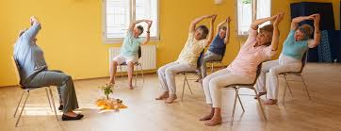
Exercise Component
The BTS guidelines on pulmonary rehabilitation (BTS, 2013)
A combination of progressive muscle resistance and aerobic training should be delivered
Exercises should be completed at a minimum of 60% peak work rate
Two sessions of supervised exercise weekly -with a third unsupervised session of prescribed exercise
Regular physical activity at least 5 x per week for 30 minutes per standard healthy living guidelines by DoH.
Note: Time exercise depends on what one can handle. After attending pulmonary rehabilitation, people are always glad how much they can exercise ; and how much less soften they feel short of breath ( Lareau & Fahy, 2018).

Slide 8
The Education Component
An essential component of treatment, education helps in:
Facilitating reduction of risk factors and improving patient’s ability to independently cope with the disease.
Improving adherence to exercise and medication,
Reducing admissions, improving mortality and improvin quality of life.
Notes:
Explain general patient understanding of these topics before educated as point of perspective

Slide 9
Enrolment and Goal Setting
Team members are:
To first step determine the short-term and long-term goals.
Encouraged to set realistic goals
Do periodic re-evaluation to ensure goals are being met.
To identify factors that can limit the program’s effectiveness: such as transportation to the rehabilitation center, financial resources, cognition (especially with respect to proper use of devices delivering inhaled drugs), and family dynamics.
Levine & Stankiewicz (2020)

Slide 10

Multidisciplinary Team
Pulmonary Rehabilitation Team medical director
Respiratory care practitioner
Nurse
Physical therapist
Exercise Physiologist
Psychologist
Vocational Counsellor
Occupational Therapist
Social worker
Nutritionist
Recreational therapist

Slide 11
Conclusion
Doctor can recommend pulmonary rehabilitation to help a patient breathe easier and improve his quality of life for given lung conditions, like: chronic obstructive pulmonary disease (COPD), pulmonary hypertension, asthma, and cystic fibrosis.
PR can also improve daily life for people who have scoliosis or other health problems limiting lung function.
Pulmonary rehabilitation can help one gain strength, reduce symptoms of anxiety or depression, and making it easier to manage daily activities.
One can get PR in the hospital or a clinic, or learn physical therapy or breathing exercises to do at home.
A team of healthcare providers can design a personal PR plan based on ones needs.

Slide 12
References
British Lung Foundation. (2020). Keeping Active With a Lung Condition. BLF. Retrieved from: https://www.blf.org.uk/support-for-you/keep-active/pulmonary-rehabilitation
British Thoracic Society guideline on pulmonary rehabilitation in adults (2013)
BTS statement (2001). British Thoracic Society standards of care subcommittee on pulmonary rehabilitation. Thorax, 56, 827-834.
Lareau, S and Fahy, B. (2018). Pulmonary Rehabilitation. American Thoracic Society. Retrieved from: https://www.thoracic.org/patients/patient-resources/resources/pulmonary-rehab.pdf

